Slide 1
Extension du formalisme SES pour l’intégration de la hiérarchie d’abstraction et la granularité temporelle au sein de la modélisation et la simulation DEVS
L. Capocchi, J.F. Santucci, B.P. Zeigler
University of Corsica
France
RTSync Corp.
USA

Slide 2
INTRODUCTION
Context of the work:
Modeling and Simulation (M&S) of Systems described according to several levels of abstraction using the DEVS formalism
Representation of DEVS hierarchical structures : System Entity Structure (SES)

Slide 3
INTRODUCTION
Proposed Approach :
What is the abstraction and time hierarchy;
Add abstraction and time hierarchy concept to the SES;
Provide operations to implement abstraction and time hierarchy into DEVS M&S.
Validation

Slide 4
Outline
Abstraction and time hierarchies, SES & DEVS
Abstraction and time hierarcies into SES & DEVS:
. Modeling aspects
. Simulation aspects
Implementation
Case Study
Conclusion

Slide 5
Outline
Abstraction and time hierarchies, SES & DEVS
Abstraction and time hierarcies into SES & DEVS:
. Modeling aspects
. Simulation aspects
Implementation
Case Study
Conclusion

Slide 6
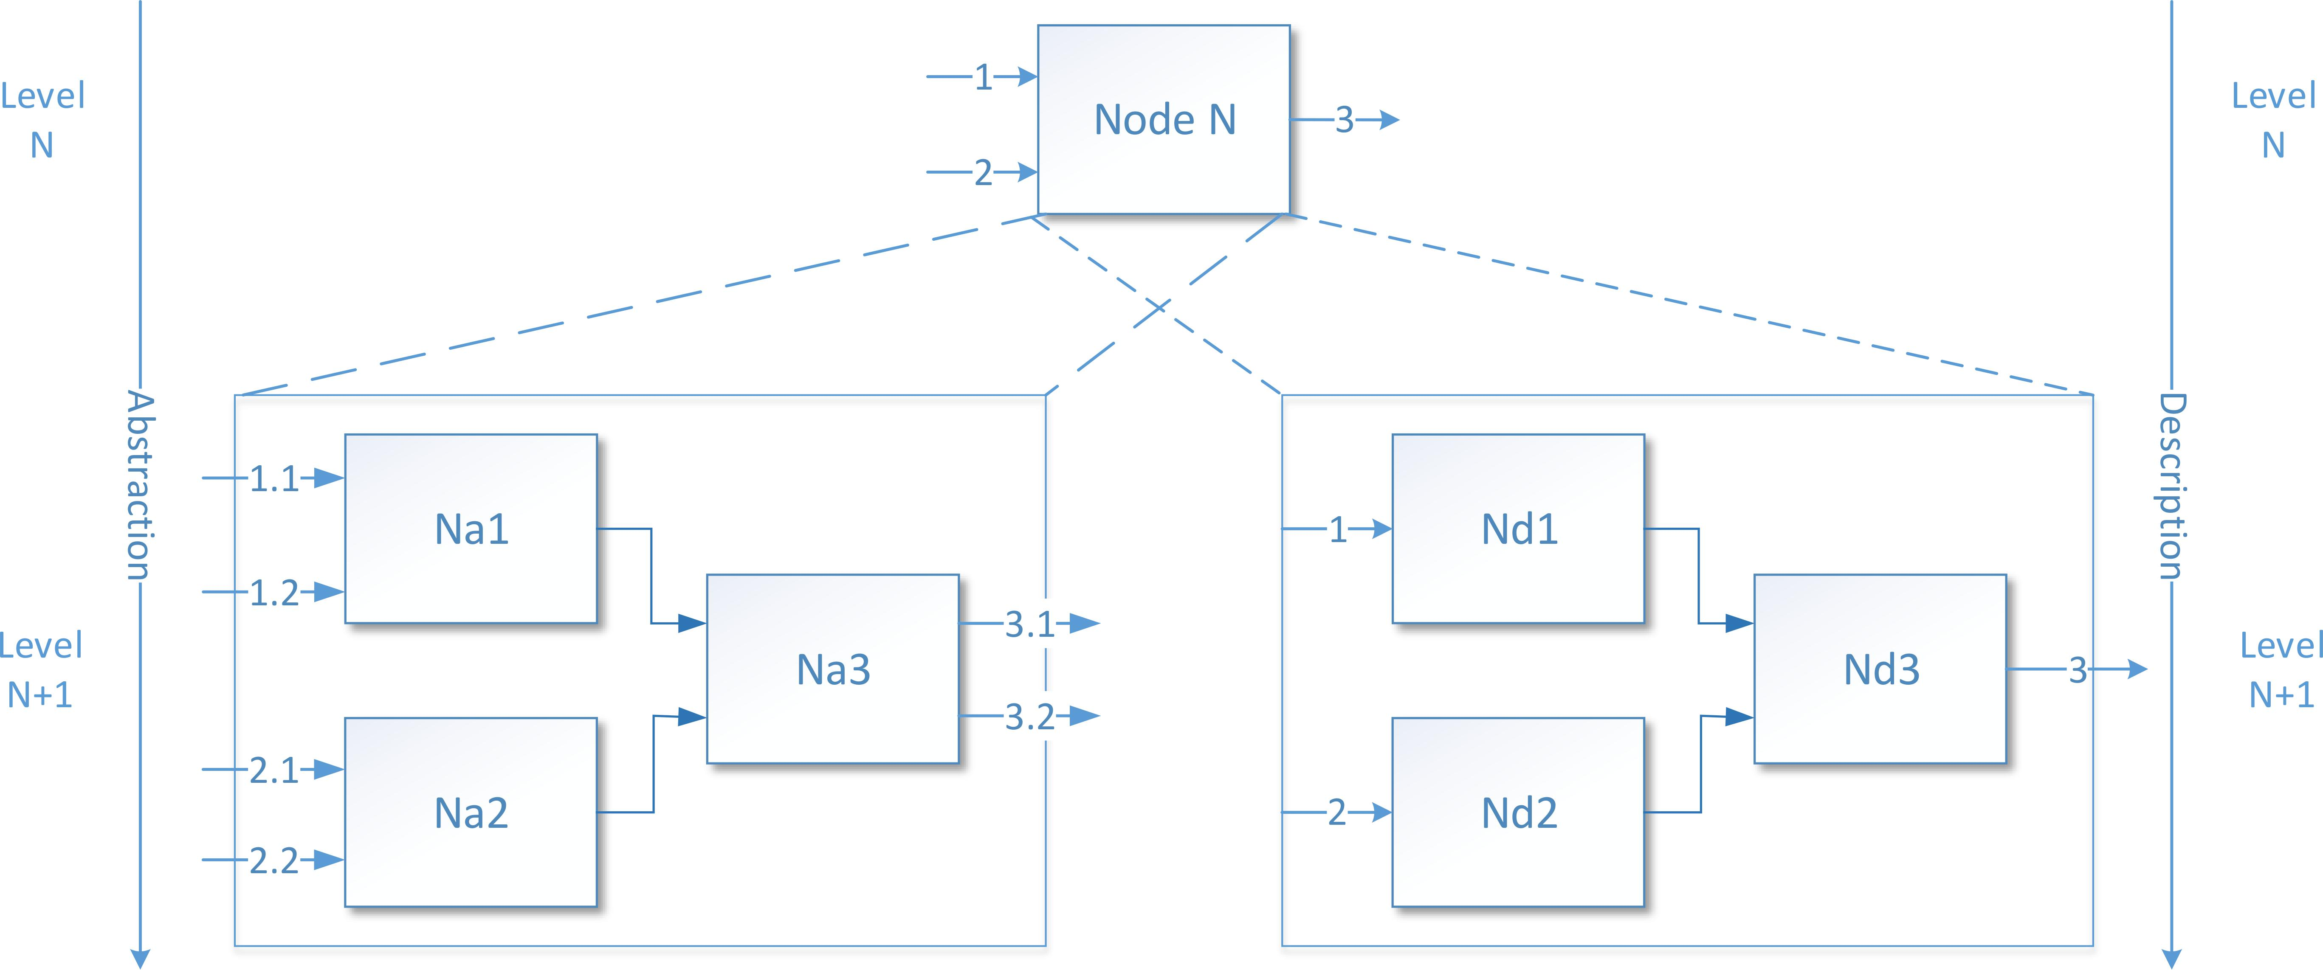
Background: Abstraction Hierarchy vs Description Hierarchy

Slide 7
Background: Time hierarchy
Time hierarchy

Slide 8
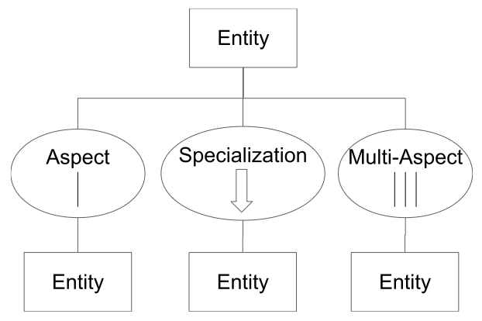
Background: SES

Slide 9
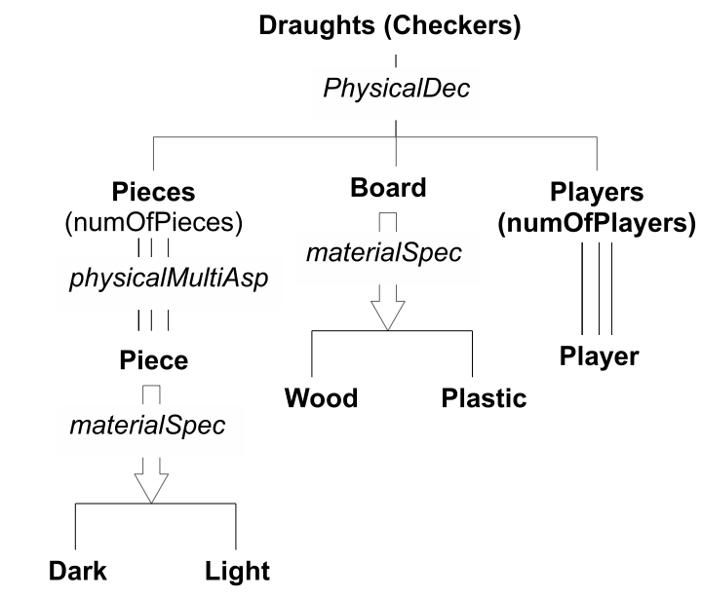
Background: SES Example
A SES involves a set of DEVS models which can be obtained by a pruning process
Pruning is an operation to cut off unnecessary structure in a SES based on the specification of a pragmatic frame
A pruned SES is transformed into a DEVS model

Slide 10
Background: DEVS and Abstraction
Two kinds of model :
Atomic Models : definition of basic behavioral description.
Coupled models : definition of the structural description of the model
Hierarchical and modular modeling
Explicit separation between the modeling and simulation parts

Slide 11
Background: DEVS DEVS
SES to DEVS models transformation

Slide 12
Outline
Background: Abstraction hierarchy, SES & DEVS
Abstraction hierarchy into SES and DEVS :
modeling aspects
Simulation aspects
Implementation
Case Study
Conclusion

Slide 13
Abstraction and Time hierarchy into SES and DEVS : Modeling Aspects
Integration of abstraction and Time Hierarchies into SES

Slide 14
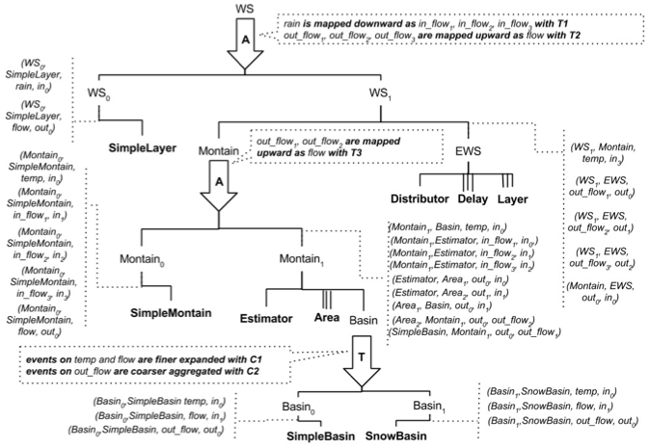
Implementation: Case Study:A Watershed behavior

Slide 15
Abstraction hierarchy into SES and DEVS : Modeling Aspects
Transfer functions between levels have to be defined:
downward functions which allow us to describe how the data are transferred from level N to level N+1 (disaggregation);
upward functions which allow to describe how the data are transferred from level N+1 to level N (aggregation).

Slide 16
Time hierarchy into SES and DEVS : Modeling Aspects
Modeling according several levels of time granularity enabled by:
adding into a given coupled model (described according to a given timebase) an atomic model whose behavior requires to be executed at a finer or coarser timebase.
Conversion functions (convert the current timebase into a finer (resp. coarser) one when going downward -from a level of granularity N to a level N+1 - (resp. upward - from a level of granularity N+1 to a level N).

Slide 17
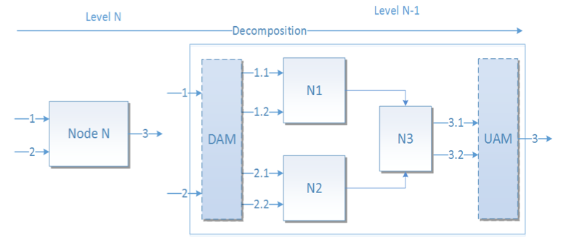
Abstraction and Time hierarchies into SES and DEVS : Simulation Aspects
Dynamically addition of two atomic models into coupled models to implement the transfer of information between levels of abstraction : the DAM (Downward Atomic Model) and the UAM (Upward Atomic Model

Slide 18
Abstraction and time hierarchies into SES and DEVS : Simulation Aspects
The transfer functions are associated with the UAM and DAM atomic models.
Concerning DAM: the transfer function is executed each time an input event is received on the input of the DMA using an external transition and output events on each one of the output ports of the DAM are generated according to the transfer function immediately (time advance = 0).
Concerning UAM: the transfer function is executed each time each input of the UAM model has received an event. As soon as this set of input events has been received, an output event is generated on the output port of the UAM model.

Slide 19
Abstraction and time hierarchies into SES and DEVS : Simulation Aspects
The timebase conversion function allowing to go from a give time granularity level to a finer one is associated with the DAM atomic model.
The timebase conversion function allowing to go from a given time granularity level to a coarser one is associated with the UAM atomic model.
A time granularity finer conversion function expresses how an event message received at time t at the granularity level N is expanded into several event messages at level N+1
A time granularity coarser conversion function expresses how a set of events collected on at level N+1 are aggregated into an event at level N.

Slide 20
Abstraction and time hierarchies into SES and DEVS : Simulation Aspects Example
For the DAM : as soon as an event is arriving as input of the model at level N let say at time t on the timebase Day, the time granularity finer conversion function associated with the DAM model is activated and allows to generated 24 events planned at time t + ₂₄¹ , t + ₂₄² , …, t + 1 on the timebase Hour
For the UAM : as soon as 24 events collected at the inputs of the UAM model on the timebase Hour, the time granularity coarser conversion function is activated and allows to aggregate the 24 events into one event at time t on the timebase Day at level N.

Slide 21
Abstraction hierarchy into SES and DEVS : Simulation Aspects
The introduction of the two kinds of atomic model DAM and UAM allows to use the classical abstract simulator concepts when performing simulation of models through several levels of abstraction or granularity

Slide 22
Outline
Abstraction and time hierarchies, SES & DEVS
Abstraction and time hierarcies into SES & DEVS:
. Modeling aspects
. Simulation aspects
Implementation
Case Study
Conclusion

Slide 23
Implementation : DEVSimPy
Open source project
Developed at University of Corsica
DEVSimPy
Object oriented framework
Dedicated to DEVS M&S
It is based on a strong notion of genericity of use
Using Python Language and the WyPython User Interface library
Environment provides a user-friendy interface for creating DEVS models
The simulation is performed by running the PyDEVS simulator

Slide 24
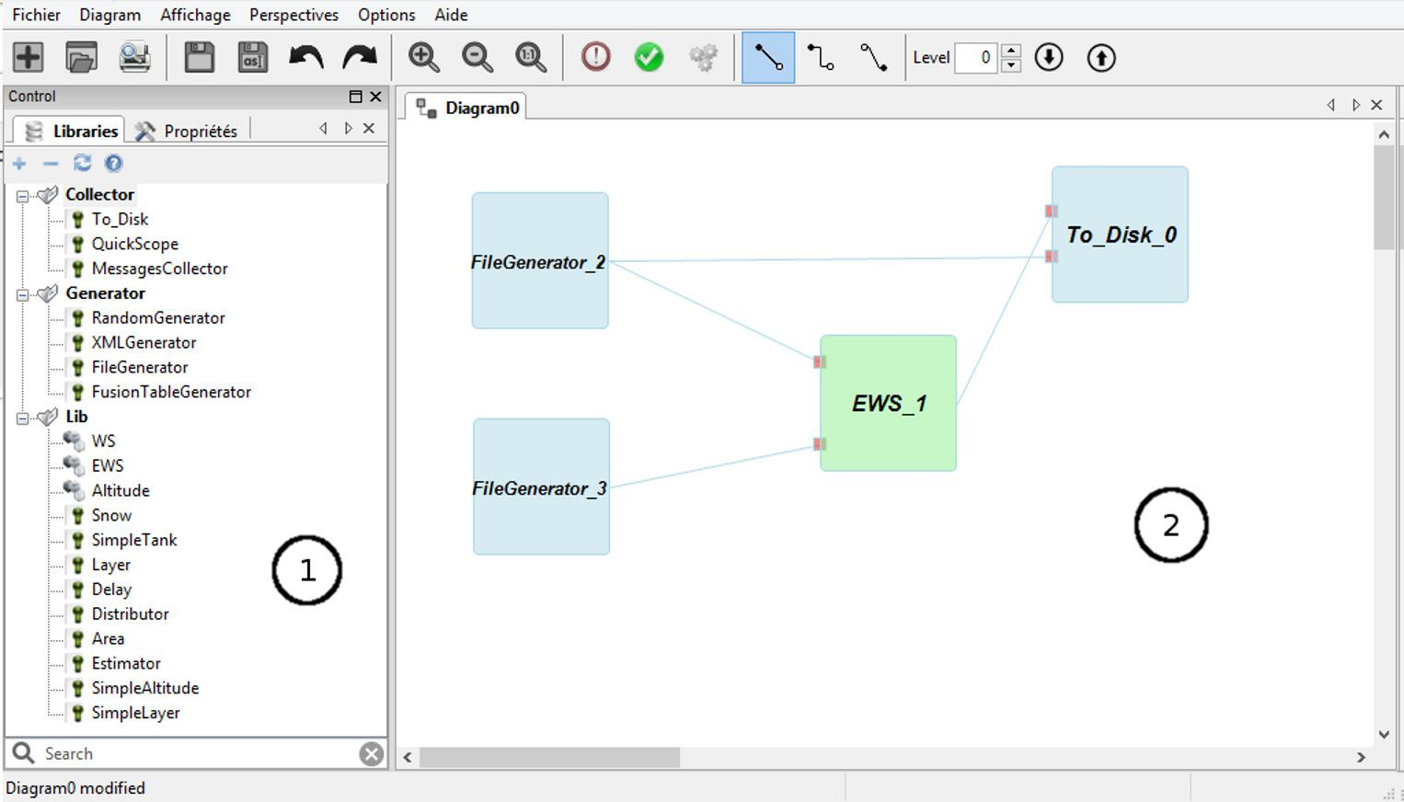
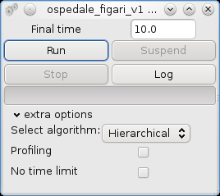
Implementation : DEVSimPy

Slide 25
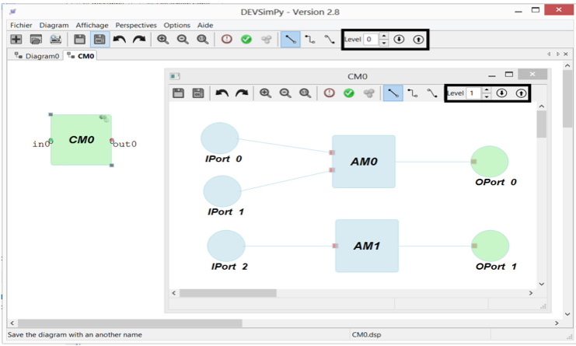
Implementation: DEVSimPy and Abstraction
When the user wants to implement an abstraction or time level in a coupled model with DEVSimPy:
it defines the level of abstraction oe time using the spin control
it specifies a behavior of two atomic models in charge of the downward/upward abstraction/conversion rules for a coupled model. The code of these two atomic models can be edited by clicking in the down (resp. up) arrow button for the DAM (resp. UAM) model.

Slide 26
Outline
Abstraction and time hierarchies, SES & DEVS
Abstraction and time hierarcies into SES & DEVS:
. Modeling aspects
. Simulation aspects
Implementation
Case Study
Conclusion

Slide 27
Implementation: Case Study:A Watershed behavior

Slide 28
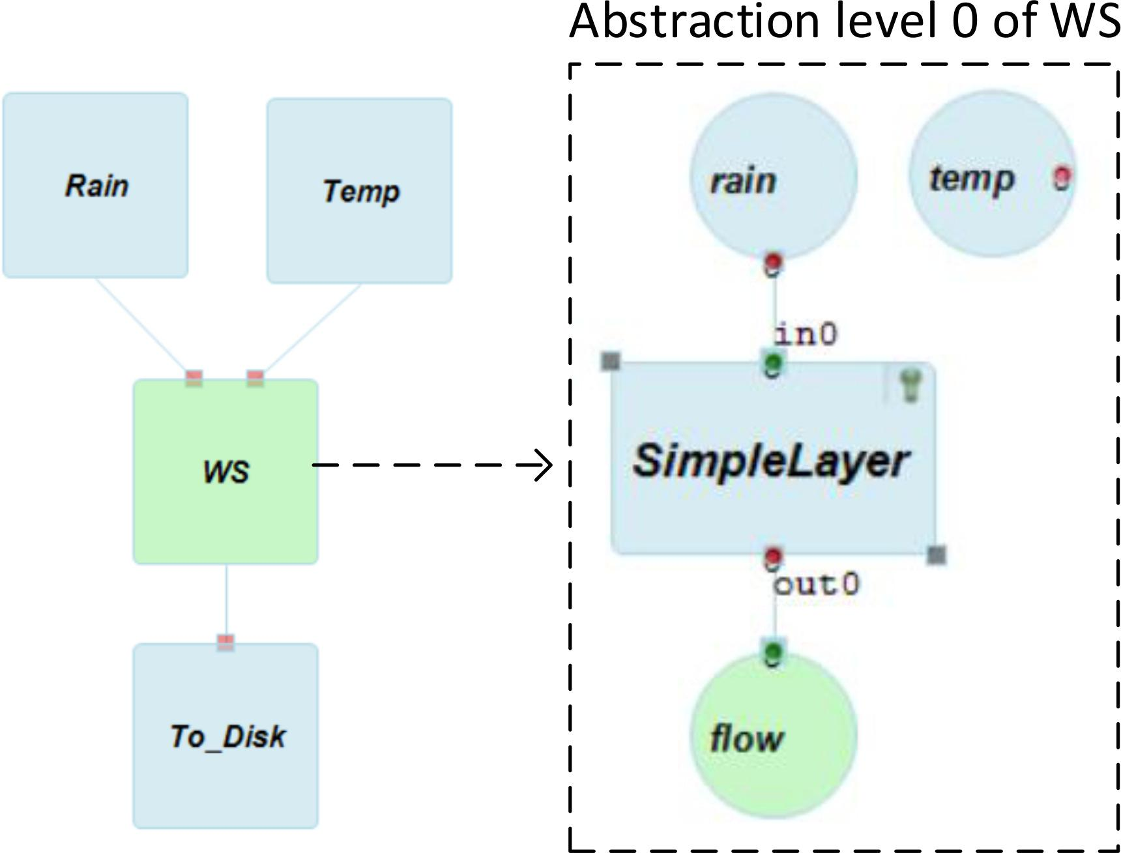
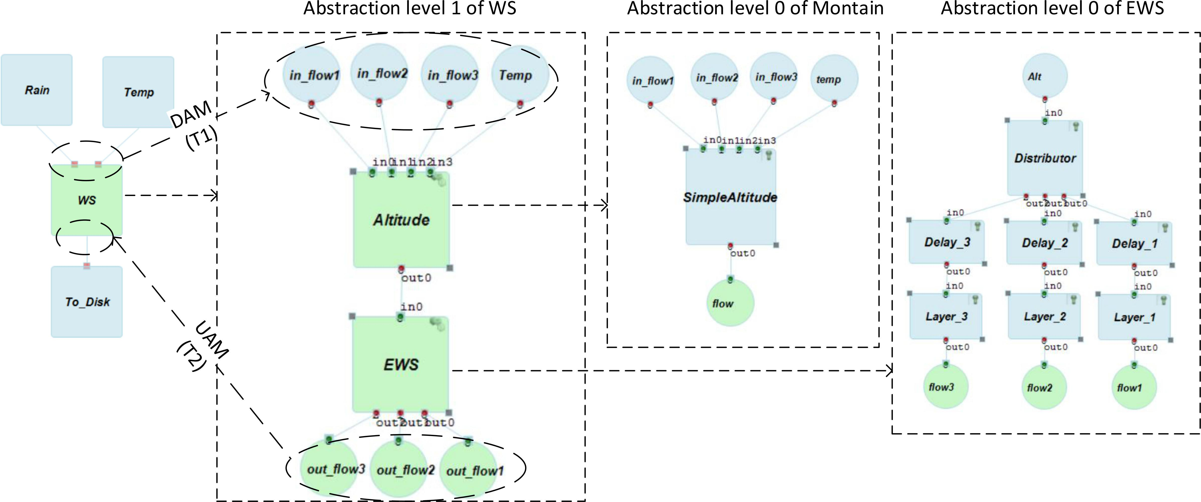
Implementation: DEVSimPy Modeling

Slide 29
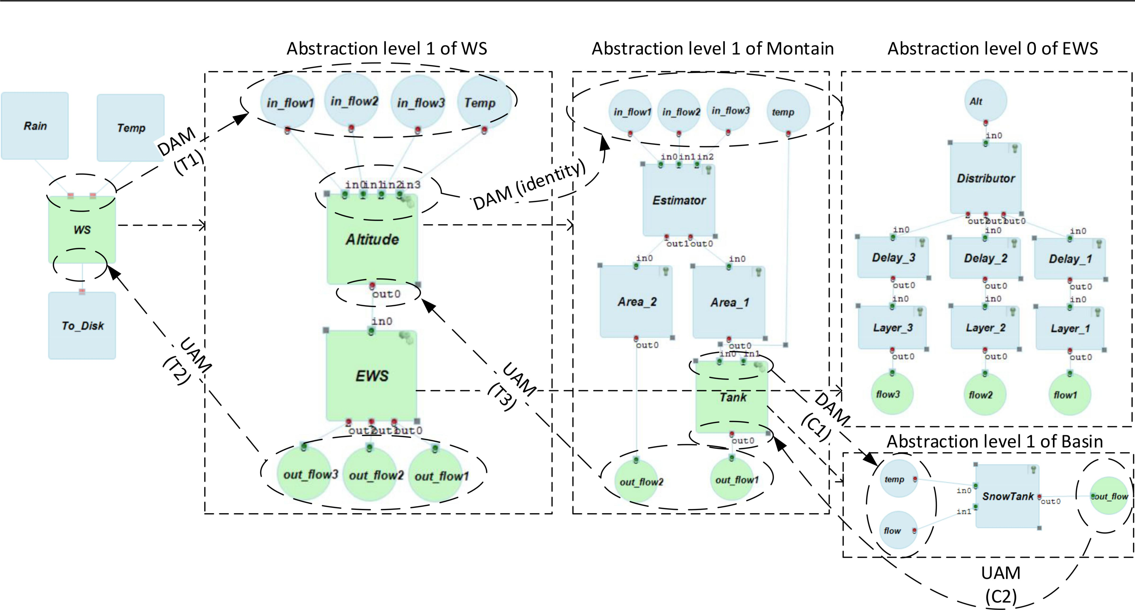
Implementation: DEVsimPY Modeling

Slide 30
Implementation: Case Study
T1: allows the downward transfer between the input port rain at level 0 of abstraction of WS and the input ports in_f low₁, in_f low₂ and in_f low₃ at level of abstraction 1 of WS. Function is defined as follows: in_f low₁ (resp. in_f low₂ and in_f low₃) = 60% (resp. 30% and 10%) of rain
T2: allows the upward transfer between the output ports out_f low₁, out_f low₂ and out_f low₃ at the level of abstraction 1 of WS and the output port f low at level of abstraction 0 of WS. This function is defined as follows f low = out_f low₁ + out_f low₂ + out_f low₃
T3: allows the upward transfer between the output ports out_f low₁ and out_f low₂ at level of 1 of Montain and the output port f low at level of 0 of Montain. This function is defined as follows: f low = out_f low₁ + out_f low₂

Slide 31
Implementation: Case Study
C1: allows the downward transfer of information between the input ports temp and f low at level of temporality 0 of Basin and the input ports in0 and in1 at level of temporality 1 of Basin. This function is defined as follows: an event at time t (daily basis) is expanded into 24 events at time t, t + ₂₄¹ , t + ₂₄² , t + ₂₄³ , …, t + 1 (hourly basis)
C2: allows the upward transfer of information between the output port out0 at level of temporality 1 of Basin and the output port out_f low at level of temporality 0 ofBasin. This function is defined as follows: it performs the sum of the values of each event arriving on port "out0" between time t and time t+1 (hourly basis) in order to define an event at time t+1 (daily basis) whose value is the previously computed sum

Slide 32
Implementation: Results
Simulation results obtained after the pruning of the SES of This pruning results in four different configurations:
W S₀ : corresponds to the level of abstraction 0 of the WS component involving the atomic model SimpleLayer
W S₁ with Montain₀ :corresponds to the level of abstraction 1 of component WS - component Montain is described at level of abstraction 0
W S₁ with ontain₁ and Basin₀ corresponds to the level of abstraction 1 of component WS -Montain is described at level of abstraction 1 and Basin described at level of temporality 0
W S₁ with Montain₁ and Basin₁ corresponds to the level of abstraction 1 of component WS -Montain is described at level of abstraction 1 and Basin described at level of temporality 1

Slide 33
Implementation: Context of the experiment
Two generator atomic models (Rain and T emp) allow to sent the among of rain and temperature of each day of a year concerning the watershed under study (situated in the French Alpes).
The W S coupled model corresponds to the models described
The DEVS simulations of the W S model have been performed for the four previously DEVS models.
The results of the simulation are expressed on the following slide thanks to the T o_Disk atomic model.
Each of these figures presents a time series comparing simulated and observed daily flows for the one-year period (365 days for the year 2009) when using each of the four previously mentioned DEVS models.

Slide 34
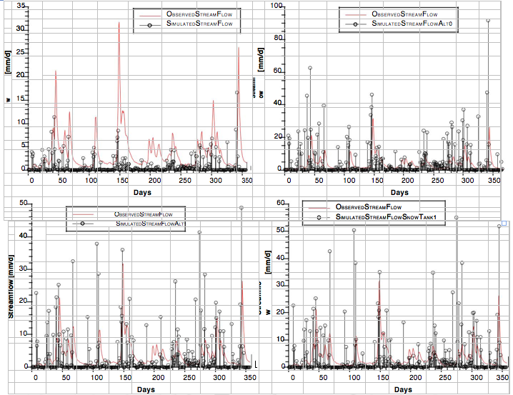
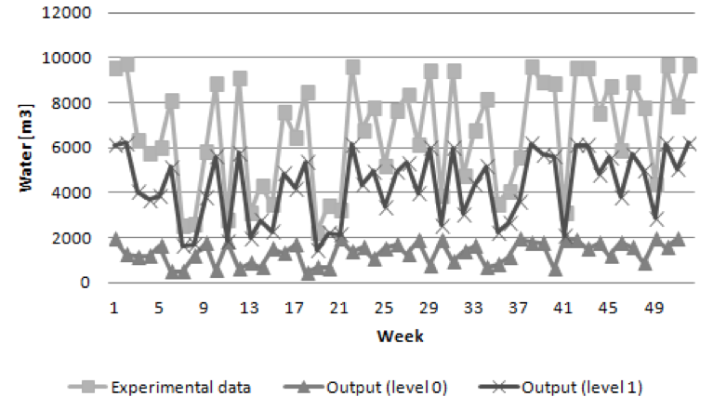
Implementation: Results

Slide 35
Outline
Background: Abstraction hierarchy, SES & DEVS
Abstraction hierarchy into SES and DEVS :
modeling aspects
Simulation aspects
Implementation
Case Study
Conclusion and Perspectives

Slide 36
Conclusion
An extension of SES has been proposed in order to integrate abstraction hierarchy in M&S.
The presented approach allows the simulation of models involving several levels of abstraction or granularity through the association of downward and upward functions to two new atomic models: DAM and UAM.
The partial implementation performed using the DEVSimPy framework has been validated on a pedagog- ical example of catchment basin behavior described using the extension of SES.

Slide 37
Conclusion: Future work
define and implement the capabilities entailed by the abstraction hierarchy theory including support for pruning the extended SES and transforming pruned entity structures into DEVS models;
SES extension in MS4Me to generate DEVS models from the proposed extended SES in the MS4Me software;
combine Activity-Based M&S concepts and Abstraction/Time hierarchies to speed up DEVS simulations.
Work on probalitistic hierarchy based on Markov lumpability

