Slide 1
PDEVS Protocol Performance Prediction using Activity Patterns with Finite Probabilistic DEVS DEMO
L. Capocchi, J.F. Santucci, B.P. Zeigler
University of Corsica
France
RTSync Corp.
USA

Slide 2
INTRODUCTION Context of the work
PDES algorithms not in general use commercially or academically
difficulties inherent in conservative and optimistic simulation algorithms persist
successes exploit properties in specific domains
models not routinely constructed for parallel computing – despite cheap multicore technology
Question costs and benefits of the available DES parallelization strategies
relatively simple PDEVS(Parallel DEVS) algorithm can reduce cost independently of application area – SpringSim 2015 paper from B.P. Zeigler,J Nutaro and C. Seo -
achieves competitive speedup

Slide 3
INTRODUCTION
Objective
to develop a methodology and tools to predict the performance of a PDEVS simulation before it is mapped to a parallel or distributed platform.
Proposed approach
to model the PDEVS (Parallel DEVS) protocol using a Markov Continuous Time Model (CTM), which is a DEVS modeling scheme that leans on FP-DEVS (Finite Probabilistic DEVS) ( in Ms4Me).
to compute, for a given Markov CTM atomic model describing the PDEVS protocol, several parameters such as the probability of a state giving an output according to input patterns and the rate of the coordinator's release of imminents (in DEVSimPy)
to insert these parameters into the PDEVS modeling scheme in order to predict the performance of the PDEVS protocol in the framework of distributed simulations.

Slide 4
Outline
PDEVS Protocol Modeling
Computation of the parameters involved in PDEVS Protocol modeling
Case Study
Conclusion

Slide 5
Outline
PDEVS Protocol Modeling
Computation of the parameters involved in PDEVS Protocol modeling
Case Study
Conclusion

Slide 6
PDEVS Protocol Modeling
Until specified number of global transitions done:
Do global transition {
For each imminent (own tN = global tN):
compute output and send it to receivers (1)
For each active (imminent and input receiver}:
compute state transition (internal, external, confl.) (2)
send own tN
)
Advance global clock, global tN = min active tNs
}
and (2) can each be executed in series or in parallel.
Imminent components execute their internal state transitions
simultaneously.

Slide 7
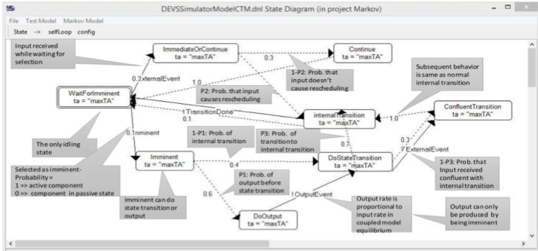
PDEVS Protocol Modeling

Slide 8
PDEVS Protocol Modeling
The State set represents the states of the PDEVS simulator as it processes the events:
WaitForImminent- Having sent the TransiionDone message to the Coordinator, the simulator is waiting for the return Imminent message (*-message, similar to time advance in HLA) which will allow it to proceed to compute its next internal transition.
Imminent-Having received the Imminent message the simulator will transition to either the DoOutput or the DoStateTransition states, depending on probability parameters of the model.
DoOutput- The simulator outputs the model’s output event and goes to DoStateTransition
DoStateTransition-The simulator performs the model’s internal transition unless it receives an external event, in which case it goes to the ConfluentTransition state
ConfluentTransition-This represents having received an external event while ready to perform an internal transition. The internal transition performed may be different from that that would have been done in DoStateTransition, but we simplify by transitioning to the same InternalTransition state.
ImmediateOrContinue- This state is entered if the simulator receives an external event while waiting for the coordinator’s imminent message. Depending on the model’s probabilities, the simulator can transition to Continue or InternalTransition.
Continue- This state represents ignoring the input and returning to WaitForImminent
InternalTransition- This state represents performing the internal transition and then sending the TransitionDone message to the coordinator.

Slide 9
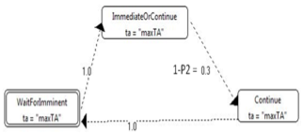
PDEVS Protocol Modeling
PDEVS protocol restricted to receive-only mode.

Slide 10
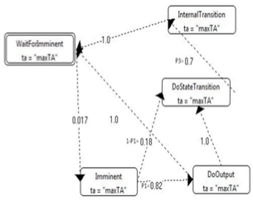
PDEVS Protocol Modeling
PDEVS protocol restricted to send-only mode.

Slide 11
PDEVS Protocol Modeling
In order to use the Markov model of the PDEVS protocol, estimate for each atomic model involved in the coupled model under study :
the probability of a state giving an output according to input patterns (called first parameter).
the rate of release of imminents by the coordinator (called second parameter)
the probability to that the simulator performs the model’s internal transition without receiving an external event (called third parameter).

Slide 12
PDEVS Protocol Modeling
These three parameters defined for each atomic model will be introduced in the corresponding CTM PDEVS model in order to specify:
The probability of output before δint (P1)
The probability that inputs cause δint (P2)
The probability that the simulator performs the model’s δint without receiving an external event (P3)
Of course we can compute their associated probabilities:
The probability of δint (1-P1)
The probability that input does not cause any rescheduling (1-P2)
The probability that the atomic model have received an external event while ready to perform an δint (1- P3)

Slide 13
PDEVS Protocol Modeling
Parallel Utilization Computed From Markov Model Steady State
Parallel Utilization is the probability of activity (other than waiting for the coordinator to activate the simulator with an imminent input)
PU = Prob. Of Activity = 1 – WaitForImminent (1)
For Receive Only Mode
p = rate of Trans. to Continue
WaitForImminent = p/(1+2p)
From (1) PU = (1+p)/(1+2p)
Use of the measurements to estimate parallel utilization will be used with the pedagogical example.

Slide 14
Outline
Background: DEVS,FPDEVS, MS4Me, DEVSimPy
PDEVS Protocol Modeling
Computation of the parameters involved in PDEVS Protocol modeling
Case Study
Conclusion

Slide 15
Parameters Computation using Activity patterns
Three parameters have to be estimated :
The probability of output before δint (P1)
The probability that inputs cause δint (P2)
The probability that the simulator performs the model’s δint without receiving an external event (P3)
For these estimations Activity Patterns Profiling is used.
The concept of activity is introduced for DEVS models as the number of transition functions executions.
This quantitative-activity (QA) metric consists in counting the number of state-to-state transitions in a model over some time interval.

Slide 16
Parameters Computation using Activity patterns
Another notion which helps to perform Activity Tracking (AT) at the simulation level is the simulation time spent by the coordinator waiting for activity.
The DEVS activity pattern profiling includes the computation of the average simulation time that a model waits for the coordinator to give it a *message which we call the *Time metric.
It also permits to compute the average simulation time (we call T metric) that it takes for a model to go from imminent to end of the δint

Slide 17
Parameters Computation using Activity patterns
The DEVS activity pattern profiling has been realized using the DEVSimPy framework
DEVSimPy implements a plug-in called «Activity Tracking »
The DEVSimPy plug-in AT is generic and can be applied to any DEVS model. It does not require any modification on the DEVS simulation algorithm and does not require any additional methods in DEVS models to operate.
The plug-in offers a table resuming the QA and *Time quantities for each tracked model

Slide 18
Parameters Computation using Activity patterns
First parameter :
The QA metric gives the number of output transition function activations with the generation of an output (QAout) as well as the δint activations (QAint) using a simulation process. The idea is to perform a set of pseudo- random generation of input patterns which are simulated in order to estimate the probability of a state giving an output according to inputs patterns. The rate is given by QAout/QAint that corresponds to the first parameter (the probability of the state giving an output).

Slide 19
Parameters Computation using Activity patterns
Second parameter:
In order to compute the second parameter (the rate of release imminents) we can point out that this rate is the inverse of the average time that a model waits for the coordinator to give a *message. This time is given by the DEVSimPy AT plug-in which computes the *Time metric
The RIT metric (Release of Imminents Time) is then obtained as the inverse of the *Time metric.

Slide 20
Parameters Computation using Activity patterns
Third parameter:
In order to compute the third parameter (the probability that the simulator performs the model’s δint without receiving an external event) we can point out that this probability can be computed as the inverse of the average time that it takes for a model to go from imminent to end of the δint. This time is given by the DEVSimPy AT plug-in which computes the T metric

Slide 21
Outline
Background: DEVS,FPDEVS, MS4Me, DEVSimPy
PDEVS Protocol Modeling
Computation of the parameters involved in PDEVS Protocol modeling
Case Study
Conclusion

Slide 22
Implementation: Case Study
This case study concerns the IEEE 802.3 CSMA/CD (Carrier Sense, Multiple Access with Collision Detection) protocol
The basic structure of the protocol is as follows: when a station has data to send, it listens to the medium, after which, if the medium was free (no one transmitting), the station starts to send its data.

Slide 23
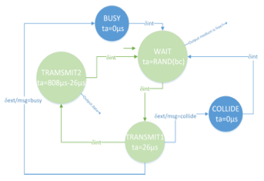
Implementation: Case Study
Station model automata

Slide 24
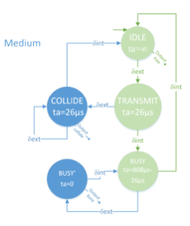
Implementation: Case Study
Medium model automata.

Slide 25
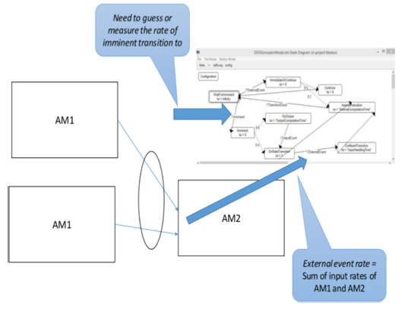
Implementation: Case Study
A DEVS coupled model involving three atomic models has been implemented in order to model the CSMA/CD protocol..

Slide 26
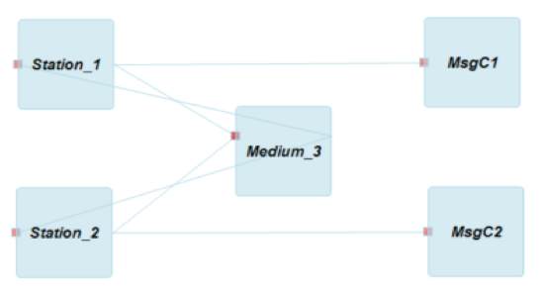
Implementation: Case Study
DEVSimPy model of the case study. “Station_1” and “Station_2” can be considered as the model AM1 and the “Medium_3” as the model AM2. Simulation has been performed during 1000 seconds (simulation time).

Slide 27
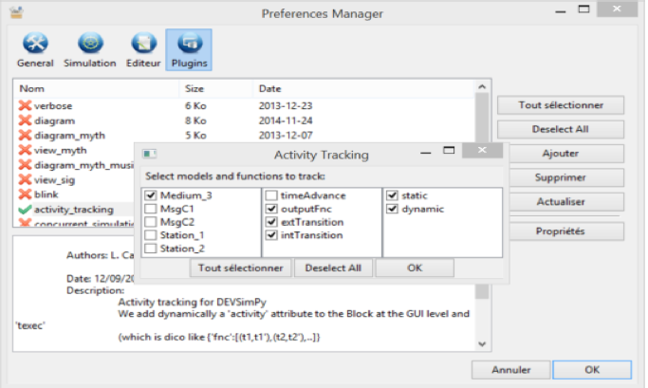
Implementation: Case Study
setup interface of AT plug-in in DEVSimPy for the DEVS model of the case study

Slide 28
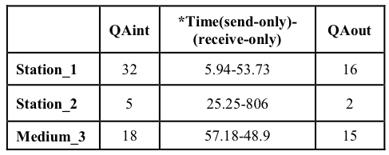
Implementation: Case Study
setup interface of AT plug-in in DEVSimPy for the DEVS model of the case study

Slide 29
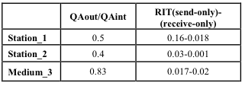
Implementation: Case Study
The QAint, QAout and RIT (1/ *Time) are used to compute the three parameters in the PDEVS protocol modeling scheme.

Slide 30
Implementation: Case Study
We have performed the simulation using the send-only mode (no external events have occurred)
for all the five states, which are active in the send only mode, associated probabilities obtained after simulation..

Slide 31
Outline
Background: DEVS,FPDEVS, MS4Me, DEVSimPy
PDEVS Protocol Modeling
Computation of the parameters involved in PDEVS Protocol modeling
Case Study
Conclusion

Slide 32
Conclusion
We have shown how activity patterns can be used in order to elaborate a modeling scheme for the PDEVS protocol using a Markov CTM DEVS atomic model. The PDEVS protocol offers a straight-forward solution to the problems raised by the conservative and optimistic algorithms.
We described how activity patterns are used to calibrate the parameters required by the CTM Markov model.

Slide 33
Conclusion: Future work
Future work: Attempt to verify that the predictions about parallel utilization using the theory are correct. These verifications will be performed using real cases of parallel and distributed implementations.

